Slide 1

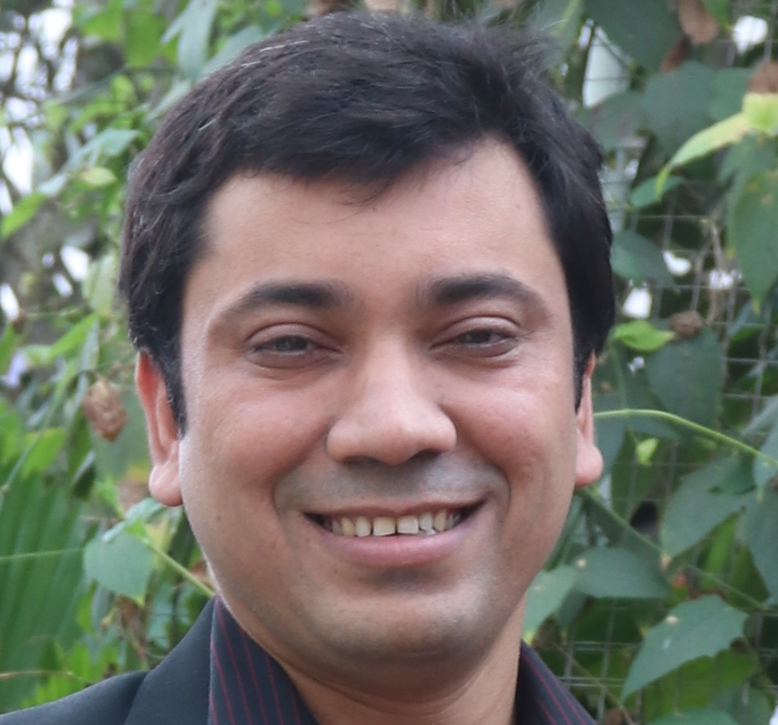
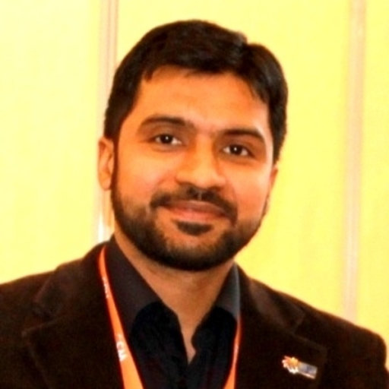


Domain Adaptation with Adversarial Training and Graph Embeddings
Firoj Alam
@firojalam04
Shafiq Joty†
Muhammad Imran
@mimran15
Qatar Computing Research Institute (QCRI), HBKU, Qatar
School of Computer Science and Engineering†
Nanyang Technological University (NTU), Singapore†
@aidr_qcri

Slide 2
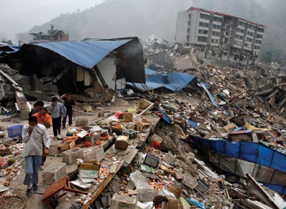
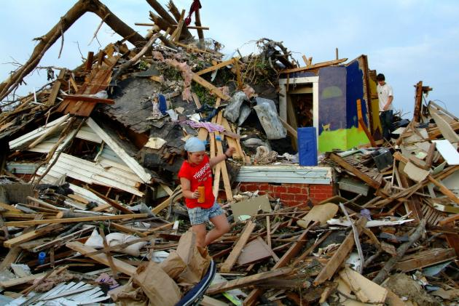
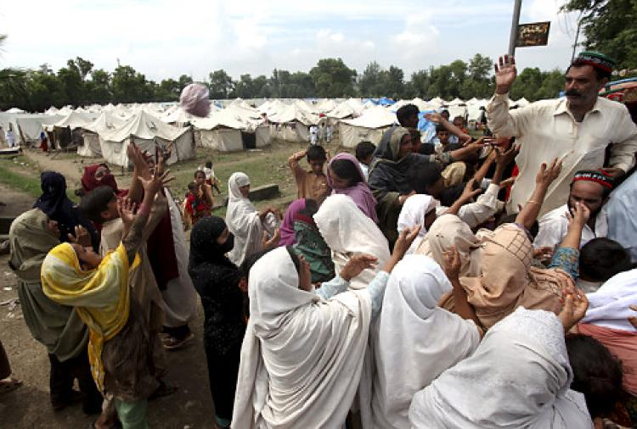
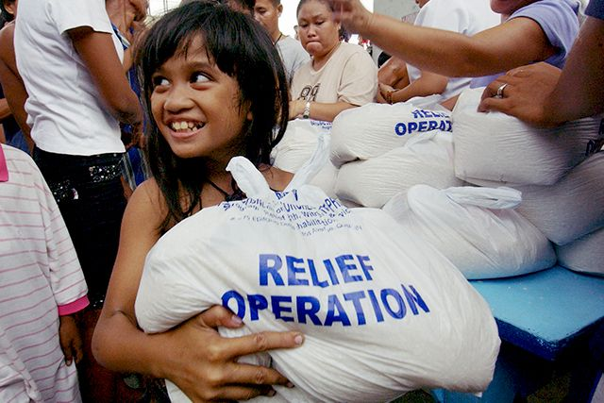




Time Critical Events
Disaster events (earthquake, flood)
Urgent needs for affected people
Food, water
Shelter
Medical assistance
Donations
Service and utilities
Information gathering in real-time is the most challenging part
Information gathering
Info.
Info.
Info.
Relief operations
Humanitarian organizations and local administration need information to help and launch response
Notes:
http://www.color-wheel-pro.com/color-meaning.html
There are many disaster events happen around the glove. In those situations there are urgent needs of affected people. And those could be need of food, water, shelter, donation, medical and other.
In order to provide response to those needs humanitarian organization requires to collect information
This information collecting part is challenging during those situations and this is where AIDR system wants to contribute.
The sooner they can get information the quicker they can provide response.
Let me talk about how AIDR system helps in collecting information…

Slide 3
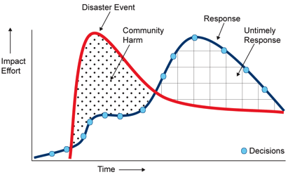
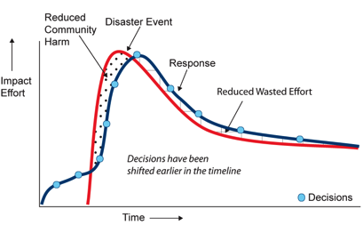
Artificial Intelligence for Digital Response (AIDR)
Response time-line today
Response time-line our target
Target
Early decision-making
Rapid crisis response
Delayed decision-making
Delayed crisis response
Target
Notes:
And we want to provide this information as quick as possible.
As you see here the more time humanitarian organization takes in their response time, damages in the community increase..
Let me try to discuss the current limitation of the AIDR system in a timeline.

Slide 4
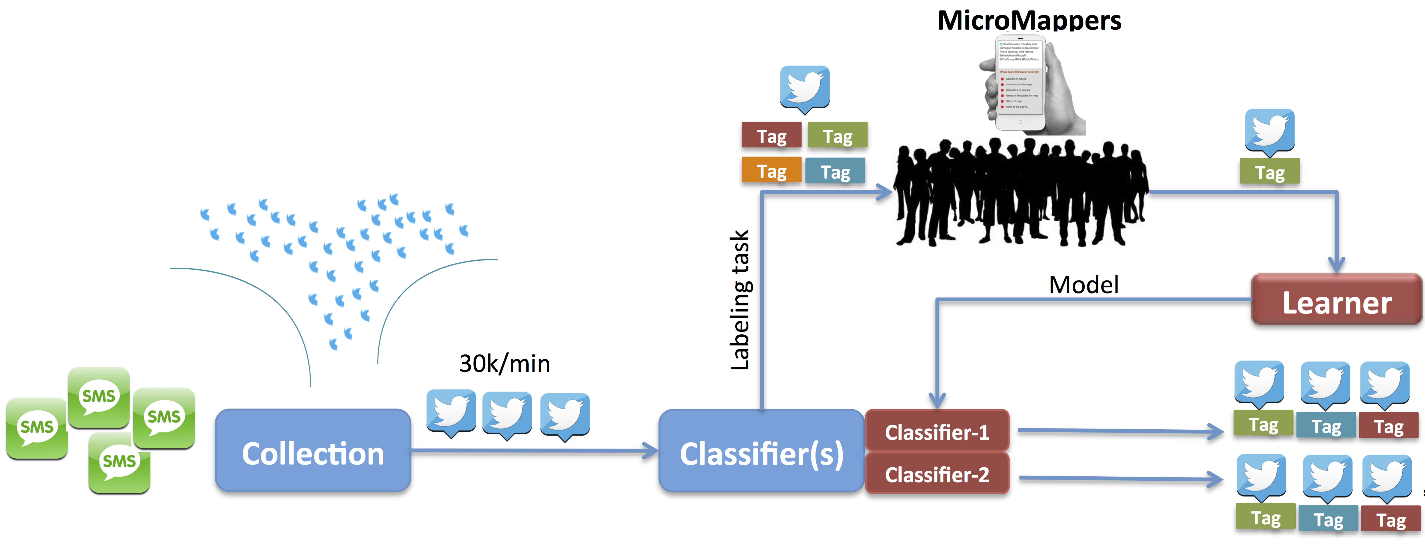

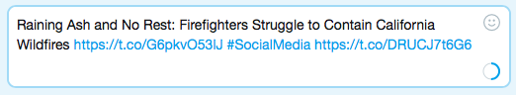
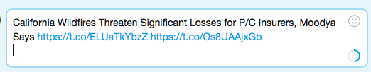
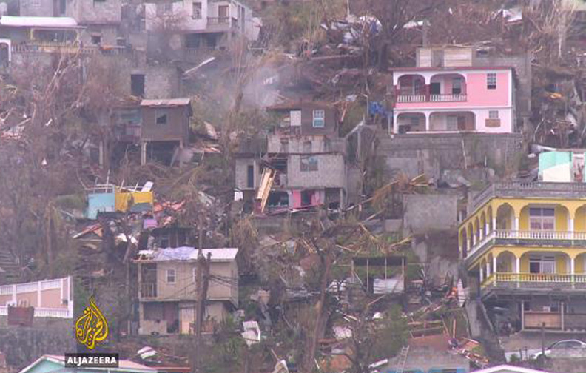
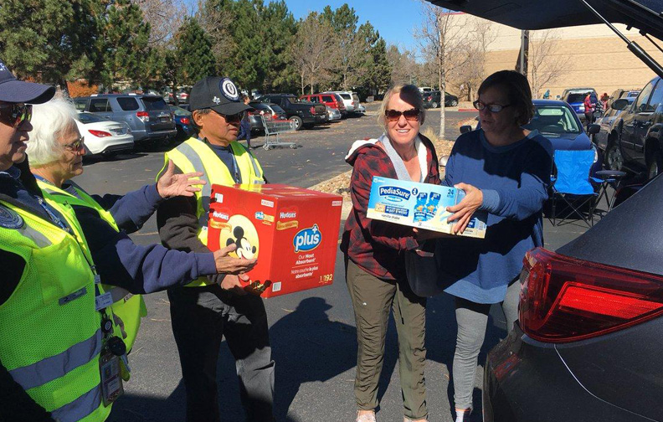

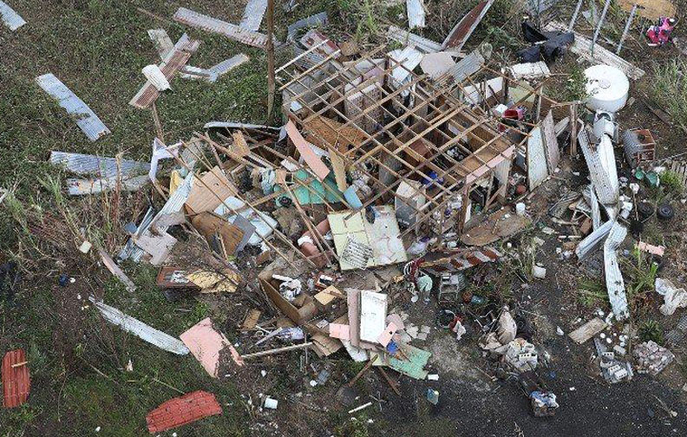
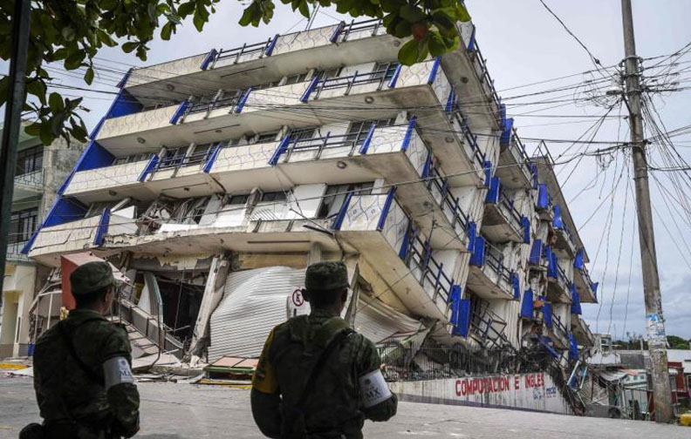
Artificial Intelligence for Digital Response
http://aidr.qcri.org
(Crowd Volunteers)
Expert/User/Crisis Manager
Text
Facilitates decision makers
Image
Notes:
This is a general top level functional view of the system.
///////Affected people post useful information such as 1) injured or dead people, 2) infrastructure damage, 3) urgent need
Whenever a crisis event happens the crisis manager starts collecting tweets using some keywords,
Since number of tweets are huge they also want to annotate them with some defined categories for that event…
These categories are unknown prior to the event and mostly specific for that event. Therefore, the system requires new annotated data to design a classifier.
As you see here the AIDR system is also connected with a pool of crowd volunteers.
So after starting the collection it request the volunteers to annotate tweets. After it receives some number of annotated tweets it designs a classifier on the fly and starts classifying new arriving tweets.
Then the crisis manager starts using the classified tweets in their decision making process.
This is how AIDR system is helping to the humanitarian organization.
So at this point do you see any limitation with this system?

Slide 5
Artificial Intelligence for Digital Response
http://aidr.qcri.org
(Crowd Volunteers)
Expert/User/Crisis Manager
Text
Facilitates decision makers
Image
Notes:
Since the annotators are volunteers, therefore, often times they do not response, which actually delays the whole process.. Getting the label data, building the classifier and providing information to the crisis managers.
And we want to address this limitation.

Slide 6
Artificial Intelligence for Digital Response
http://aidr.qcri.org
(Crowd Volunteers)
Expert/User/Crisis Manager
Small amount of label data and large amount of unlabeled data at the beginning of the event
Can we use labeled data from the past event? What about domain shift?
Text
Facilitates decision makers
Image
Notes:
Hence in order to replace the dependency of the Crowd volunteers we have two scenarios that we wanted to address:
Distribution drift: generally statistical models assume that the distribution of data stays the same over time. But in practice, the distribution of data changes constantly, sometimes drastically. This is called distribution drift.

Slide 7
Our Solutions/Contributions
How to use large amount of unlabeled data and small amount of labeled data from the same event?
Graph-based semi-supervised

Slide 8
Our Solutions/Contributions
How to use large amount of unlabeled data and small amount of labeled data from the same event?
Graph-based semi-supervised
How to transfer knowledge from the past events
=> Adversarial domain adaptions

Slide 9
Domain Adaptation with Adversarial Training and Graph Embeddings
Shared Components
Input tweet
Dense (z_{c})
w₁
Convolution
Dense (z)
Class label
Softmax
Supervised
loss L_{C}
w₂
Dense (z_{s})
Softmax
Semi-Supervised
Graph context
loss L_{G}
Dense (z_{g})
w_{n-1}
Sigmoid
Domain adversary
loss L_{D}
w_{n}
Domain label
Feature map
Dense (z_{d})
Pre-trained Word Embeddings
Max pooling
Gradient reversal
Notes:
So we propose this network, which uses data from the past event data and small label data from the current event.
This has three different components: 1) supervised, 2) semi-supervised and 3) Domain adversary.
I will walk through you one by one.

Slide 10

Supervised Learning
Shared Components
Input tweet
Dense (z_{c})
w₁
Convolution
Dense (z)
Class label
Softmax
Supervised
loss L_{C}
w₂
w_{n-1}
w_{n}
Feature map
Pre-trained Word Embeddings
Max pooling
Notes:
The first part is supervised learning part:
Here, we have Convolution, max pooling, dense layer and finally softmax layer.
The input to the network is n-words in a tweet with d-dimensional vector from a pre-trained word-embeddings.
We apply convolution filter to each possible k length windows in input matrix (X) we have a feature map
Each feature map contains n+2o-k+1 features.
This process repeated N time to N different filters, results in N feature maps
Then after applying max pooling operation to each of the feature maps, we have a fully connected layer
Filter size: we use 2, 3 and 4

Slide 11
Semi-Supervised Learning
Semi-Supervised component
Shared Components
Input tweet
Dense (z_{c})
w₁
Convolution
Dense (z)
Class label
Softmax
Supervised
loss L_{C}
w₂
Dense (z_{s})
Softmax
Semi-Supervised
Graph context
loss L_{G}
Dense (z_{g})
w_{n-1}
w_{n}
Feature map
Pre-trained Word Embeddings
Max pooling

Slide 12
Semi-Supervised Learning
L: number of labeled instances (x_{1:L,} y_{1:L})
U: number of unlabeled instances (x_{L+1:L+U})
Design a classifier
Notes:
Learning better representations and improve generability

Slide 13




Graph based Semi-Supervised Learning
Positive
Negative
D1
D4
Similarity
0.7
0.3
0.6
D2
D3
Assumption: If two instances are similar according to the graph, then class labels should be similar
Notes:
There are many approaches of semi-supervised learning: generative based (expectation maximization), label propagation, co-training, self-training, and graph-based
We focused on graph based approach
WHY Graph based??
It has proven success recently for semi-supervised learning.
Graph based methods define a graph where nodes are labeled and unlabeled examples in the dataset and edges reflect the similarity between them.
Graph based methods are nonparametric, discriminative in nature.

Slide 14
Graph based Semi-Supervised Learning
Positive
Negative
D1
D4
Similarity
0.7
0.3
0.6
D2
D3
Positive
Negative
Two Steps:
Graph Construction
Classification

Slide 15
Graph based Semi-Supervised Learning
Graph Representation
Nodes: Instances (labeled and unlabeled)
Edges: n x n similarity matrix
Each entry a_{i,j} indicates a similarity between instance i and j

Slide 16
Graph based Semi-Supervised Learning
Graph Construction
We construct the graph using k-nearest neighbor (k=10)
Euclidian distance
Requires n(n-1)/2 distance computation
K-d tree data structure to reduce the computational complexity O(logN)
Feature Vector: taking the averaging of the word2vec vectors
Input tweet
w₁
Taking the average
w₂
w_{n}
Notes:
The time-complexity of the K-nearest neighbor is quadratic O(n^2).
To reduce the computational cost we considered 10 nearest instances
K-d tree: O(N), depth O(lgN), construction time O(NlgN)
K=40 in K-d tree
Search time: O(lgN)
KNN: given a set S of points in a space M and a query point q ∈ M, find the closest points in S to q.
K-d tree is a space-partitioning data structure for organizing points in a k-dimensional space.
Find approximate nearest neighbors in a (relatively) low-dimensional real-valued space.
When we get a new data instance, we find the matching leaf of the K-D tree, and compare the instance to all the training point in that leaf.

Slide 17
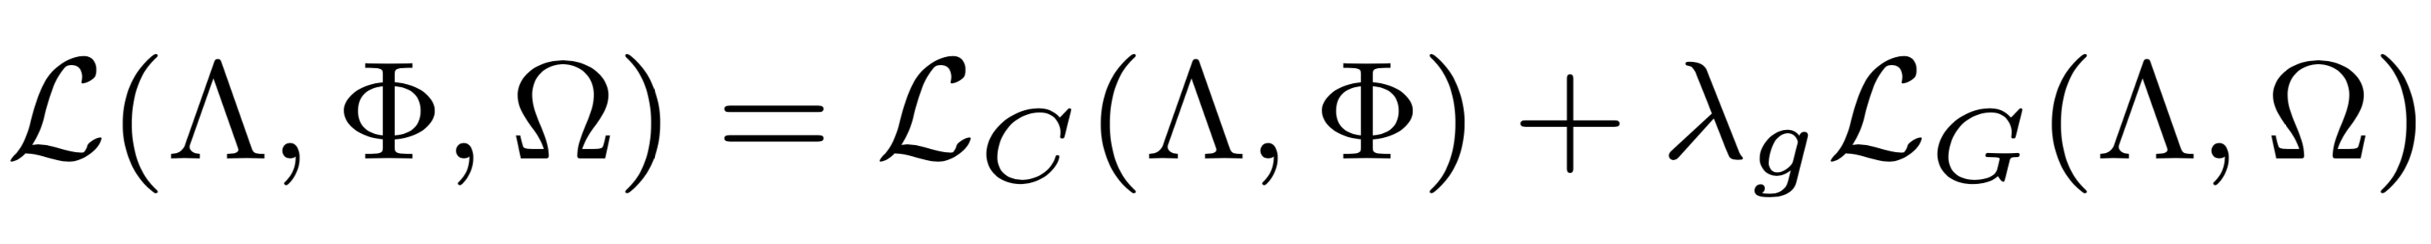
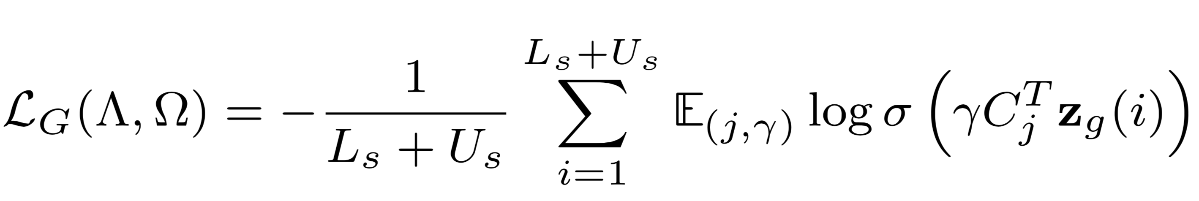
Graph based Semi-Supervised Learning
Semi-Supervised component: Loss function
Graph context loss
(Yang et al., 2016)
Learns the internal representations (embedding) by predicting a node in the graph context
Notes:
The semi-supervised part induces the structural similarity between labeled and unlabeled instances, which is done by learning embedding from a similarity graph
Uses activations from both supervised and semi-supervised parts
There are two types of context that are sampled:
1) First type of context is based on the graph A, which encodes the structure (distributional) information
2) The second type of context is based on the labels in order to inject label information into the embeddings

Slide 18
Graph based Semi-Supervised Learning
Semi-Supervised component: Loss function
(Yang et al., 2016)
Two types of context
Context is based on the graph to encode structural (distributional) information
Notes:
The semi-supervised part induces the structural similarity between labeled and unlabeled instances, which is done by learning embedding from a similarity graph
Uses activations from both supervised and semi-supervised parts
There are two types of context that are sampled:
1) First type of context is based on the graph A, which encodes the structure (distributional) information
2) The second type of context is based on the labels in order to inject label information into the embeddings

Slide 19
Graph based Semi-Supervised Learning
Semi-Supervised component: Loss function
(Yang et al., 2016)
Two types of context
Context is based on the graph to encode structural (distributional) information
Context is based on the labels to inject label information into the embeddings
Notes:
The semi-supervised part induces the structural similarity between labeled and unlabeled instances, which is done by learning embedding from a similarity graph
Uses activations from both supervised and semi-supervised parts
There are two types of context that are sampled:
1) First type of context is based on the graph A, which encodes the structure (distributional) information
2) The second type of context is based on the labels in order to inject label information into the embeddings

Slide 20
Graph based Semi-Supervised Learning
Semi-Supervised component: Loss function
Convolution filters and dense layer parameters
Parameters specific to the supervised part
Parameters specific to the semi-supervised part
Notes:
As parameters, we have …

Slide 21
Domain Adaptation with Adversarial Training and Graph Embeddings
Shared Components
Input tweet
Dense (z_{c})
w₁
Convolution
Dense (z)
Class label
Softmax
Supervised
loss L_{C}
w₂
Dense (z_{s})
Softmax
Semi-Supervised
Graph context
loss L_{G}
Dense (z_{g})
w_{n-1}
Sigmoid
Domain adversary
loss L_{D}
w_{n}
Domain label
Feature map
Dense (z_{d})
Pre-trained Word Embeddings
Max pooling
Gradient reversal
Notes:
Let us see the domain adversarial component:
Distribution drift: generally statistical models assume that the distribution of data stays the same over time. But in practice, the distribution of data changes constantly, sometimes drastically. This is called distribution drift.
So in our model we added domain adversarial component.
This part takes shared representation of the source and target domains as input and tries to discriminate between them.
(The domain discriminator) this is adversarial with respect to the shared layers and it is done by using gradient reversal during back propagation.
During the training it tries to maximize the loss of the discriminator

Slide 22
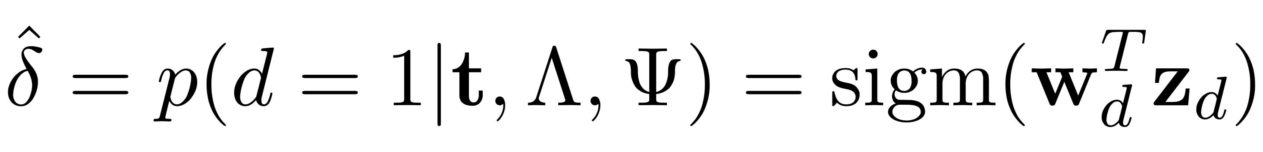
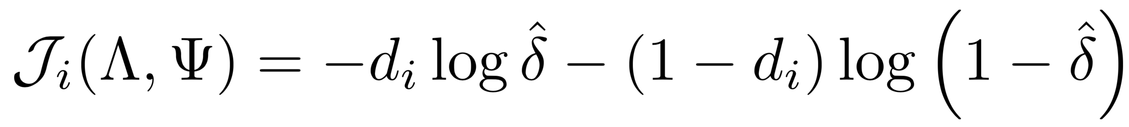
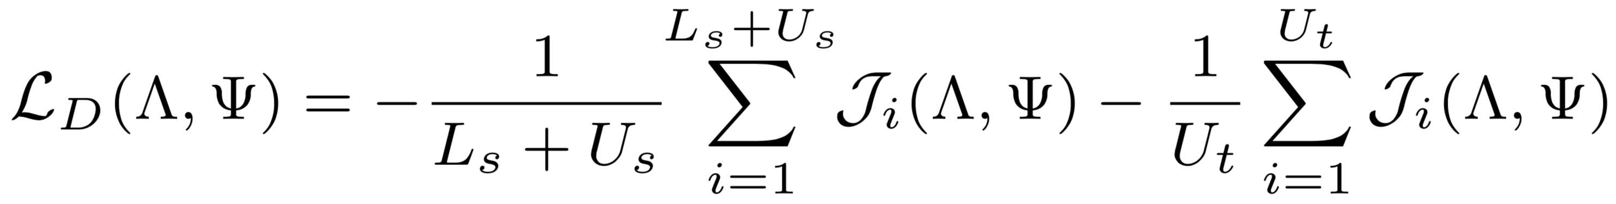
Domain Adaptation with Adversarial Training
Domain discriminator is defined by:
Negative log probability of the discriminator loss:
Domain adversary loss is defined by:
d ∈ {0,1} represents the domain of the input tweet t
Convolution filters and dense layer parameters
Parameters specific to the domain discriminator part
Notes:
Here in the discriminator we use sigmoid function. d{0,1} represents the domain of the input tweet.
Wd is the final layer weight of the discriminator, zd defines the hidden layer of the discriminator
Lambda defines the shared parameter, and psi represents parameters specific to the domain discriminator
In the adversary loss we are trying to maximize the loss,
We are using labeled and unlabeled data from source and unlabeled data from target.

Slide 23

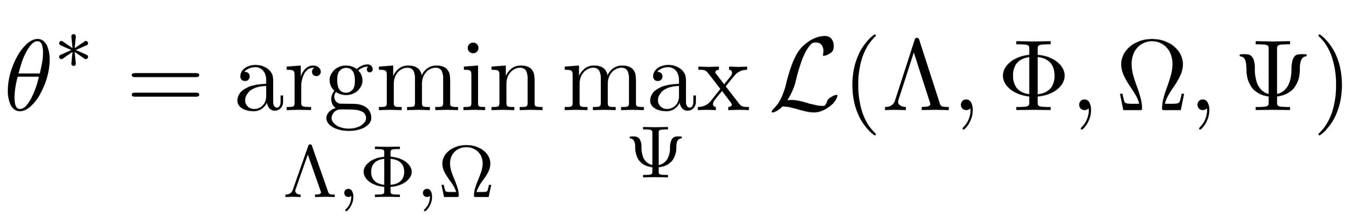
Domain Adaptation with Adversarial Training and Graph Embeddings
Combined loss
Domain adversarial loss
Supervised
Semi-Supervised
We seek parameters that minimizes the classification loss of the class labels and maximizes domain discriminator loss
Convolution filters and dense layer parameters
Parameters specific to the supervised part
Parameters specific to the semi-supervised part
Parameters specific to the domain discriminator part
Notes:
Finally, we combine supervised, semi-supervised and domain adversary loss.

Slide 24
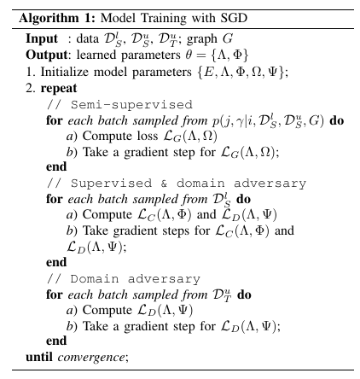
Model Training
Notes:
For the training, we initializes word-embedding matrix using a pertained model and choose parameters using uniform distribution
In each iteration of the training, we update three different types of loss functions.
We used early-stopping technique based on F-measure, and stop the training if f-score does not increase after 25 epochs.

Slide 25
Corpus
Collected during:
2015 Nepal earthquake
2013 Queensland flood
A small part of the tweets has been annotated using crowdflower
Relevant: injured or dead people, infrastructure damage, urgent needs of affected people, donation requests
Irrelevant: otherwise
Dataset | Relevant | Irrelevant | Train (60%) | Dev (20%) | Test (20%)
Nepal earthquake | 5,527 | 6,141 | 7,000 | 1,167 | 3,503
Queensland flood | 5,414 | 4,619 | 6,019 | 1,003 | 3,011
Unlabeled Instances
Nepal earthquake: 50K
Queensland flood: 21K

Slide 26
Experiments and Results
Supervised baseline:
Model trained using Convolution Neural Network (CNN)
Semi-Supervised baseline (Self-training):
Model trained using CNN were used to automatically label unlabeled data
Instances with classifier confidence >=0.75 were used to retrain a new model
Classifier confidence > 0.75
Unlabeled data
Training data
Training
Training
Model
Test data
Evaluation
Notes:
For the experiments, we have different types of baseline: supervised, semi-supervised (self-training)

Slide 27
Experiments and Results
Semi-Supervised baseline (Self-training)
Experiments | AUC | P | R | F1
Nepal Earthquake
Supervised | 61.22 | 62.42 | 62.31 | 60.89
Semi-Supervised (Self-training) | 61.15 | 61.53 | 61.53 | 61.26
Semi-Supervised (Graph-based) | 64.81 | 64.58 | 64.63 | 65.11
Queensland Flood
Supervised | 80.14 | 80.08 | 80.16 | 80.16
Semi-Supervised (Self-training) | 81.04 | 80.78 | 80.84 | 81.08
Semi-Supervised (Graph-based) | 92.20 | 92.60 | 94.49 | 93.54
Notes:
Graph based approach show 4% to 13% improvement of F1 over the baseline

Slide 28
Experiments and Results
Domain Adaptation Baseline (Transfer Baseline): Trained CNN model on source (an event) and tested on target (another event)
Source | Target | AUC | P | R | F1
In-Domain Supervised Model
Nepal | Nepal | 61.22 | 62.42 | 62.31 | 60.89
Queensland | Queensland | 80.14 | 80.08 | 80.16 | 80.16
Transfer Baseline
Nepal | Queensland | 58.99 | 59.62 | 60.03 | 59.10
Queensland | Nepal | 54.86 | 56.00 | 56.21 | 53.63

Slide 29
Experiments and Results
Domain Adaptation
Source | Target | AUC | P | R | F1
In-Domain Supervised Model
Nepal | Nepal | 61.22 | 62.42 | 62.31 | 60.89
Queensland | Queensland | 80.14 | 80.08 | 80.16 | 80.16
Transfer Baseline
Nepal | Queensland | 58.99 | 59.62 | 60.03 | 59.10
Queensland | Nepal | 54.86 | 56.00 | 56.21 | 53.63
Domain Adversarial
Nepal | Queensland | 60.15 | 60.62 | 60.71 | 60.94
Queensland | Nepal | 57.63 | 58.05 | 58.05 | 57.79

Slide 30
Experiments and Results
Combining all the components of the network
Source | Target | AUC | P | R | F1
In-Domain Supervised Model
Nepal | Nepal | 61.22 | 62.42 | 62.31 | 60.89
Queensland | Queensland | 80.14 | 80.08 | 80.16 | 80.16
Transfer Baseline
Nepal | Queensland | 58.99 | 59.62 | 60.03 | 59.10
Queensland | Nepal | 54.86 | 56.00 | 56.21 | 53.63
Domain Adversarial
Nepal | Queensland | 60.15 | 60.62 | 60.71 | 60.94
Queensland | Nepal | 57.63 | 58.05 | 58.05 | 57.79
Domain Adversarial with Graph Embedding
Nepal | Queensland | 66.49 | 67.48 | 65.90 | 65.92
Queensland | Nepal | 58.81 | 58.63 | 59 | 59.05

Slide 31
Summary
We have seen how graph-embedding based semi-supervised approach can be useful for small labeled data scenario
How can we use existing data and apply domain adaptation technique
We propose how both techniques can be combined
Notes:
So in our study we focused on two interesting problems: 1) small amount of labeled data and lots of unlabeled data, 2) existing labeled and unlabeled data

Slide 32
Limitation and Future Study
Limitations:
Graph embedding is computationally expensive
Graph constructed using averaged vector from word2vec
Explored binary class problem
Future Study
Convoluted feature for graph construction
Hyper-parameter tuning
Domain adaptation: labeled and unlabeled data from target
Notes:
Performance of deep neural network heavily depend on parameter tuning.

Slide 33
Thank you!
To get the data: http://crisisnlp.qcri.org/
Please follow us @aidr_qcri
Firoj Alam, Shafiq Joty, Muhammad Imran. Domain Adaptation with Adversarial Training and Graph Embeddings. ACL, 2018, Melbourne, Australia.

